Slide 1

Project Title:
Road Accident Analysis & Severity Prediction
Presented by:
Mohamed Ashraf
Sara Alzoghby
Salma Hesham
Elsayed alaa
Mai Yousri
Hassan Gooda
Date:30/11/2025

Slide 2
Problem Description:
Road accidents are increasing due to various factors such as driver behavior, vehicle conditions, and road environment.
However, authorities often lack a clear, data-driven understanding of why accidents occur and how severe the outcomes will be.
Proposed Solution (High-Level Idea):
Our project analyzes real accident data to identify key patterns and factors contributing to crashes.
Using Machine Learning, we built a model that predicts the severity of casualty outcomes (survived / not survived), and we combined this with an interactive dashboard and AI-powered GUI for easy decision-making.
Unique Value Proposition:
Integrates data analysis + AI prediction in one system.
Provides authorities with actionable insights to reduce accident risks.
Predicts casualty severity instantly to support faster emergency response.
User-friendly GUI makes the system accessible to non-technical users.

Slide 3
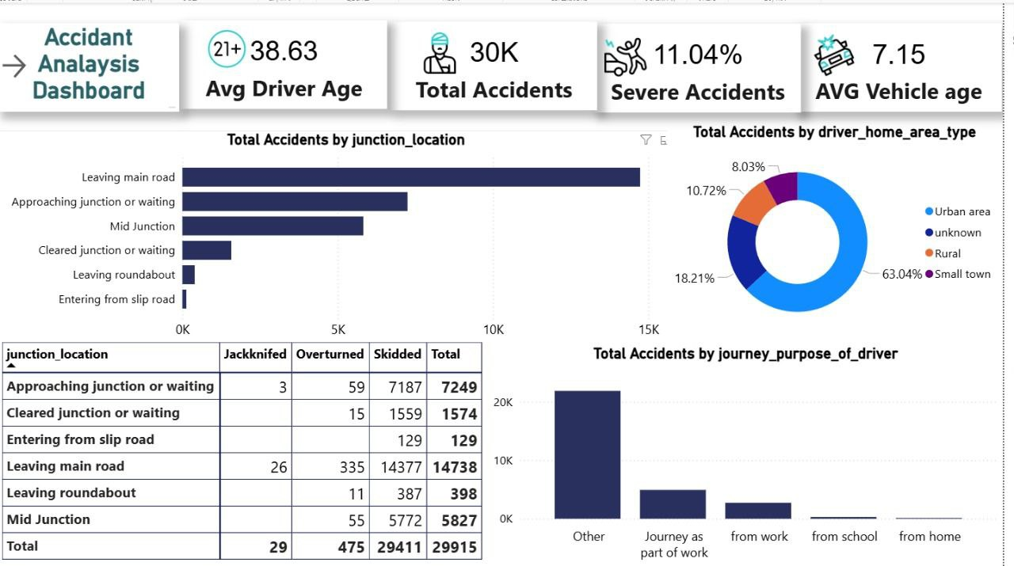

Key Interfaces:
Homepage: Welcome screen with quick links to Dashboard & AI Analysis.
Dashboard: Summary of accidents, interactive charts, filters by date, vehicle type, and location.
AI Model GUI: Input accident data → Predict severity → View results & export report.
User Journey:
User login
Dashboard overview
Select or input accident data
AI predicts severity & possible outcome
View/export report
UX Highlights:
Simple & clear design
Interactive charts for quick insights
Clear buttons & elements for easy navigation

Slide 4
Primary Users:
Government & Traffic Authorities: Monitor accidents and prevent future incidents.
Insurance Companies: Assess accident severity and predict potential claims.
Researchers & Analysts: Study accident patterns and trends.
Key Features:
Accident Analysis Dashboard: Quick overview of accident statistics.
AI Severity Prediction: Predicts the outcome of accidents (Survived / Serious / Fatal).
Data Filtering & Visualization: Filter by vehicle type, location, driver age, etc.
Report Generation: Export detailed reports for authorities or insurance.
How Features Solve Problems:
Authorities: Identify high-risk locations and take preventive actions.
Insurance Companies: Evaluate potential claim costs and risks quickly.
Researchers: Analyze patterns and trends to propose safety improvements.

Slide 5
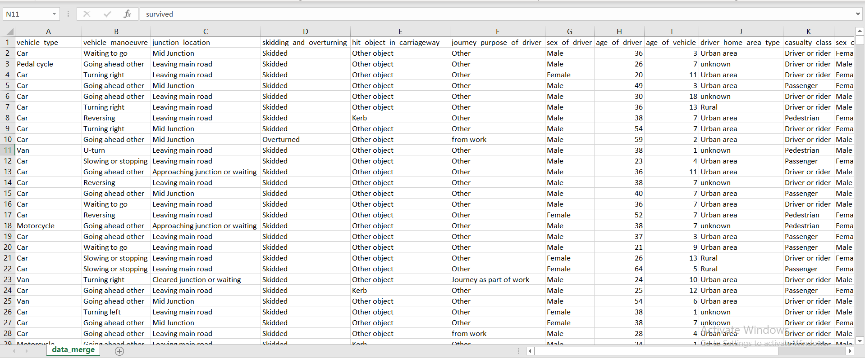

Database Type:
Relational / Tabular CSV Data
Each row represents a single accident record.
Key Entities & Features:
Vehicle Information: vehicle_type, vehicle_manoeuvre, age_of_vehicle
Driver Information: sex_of_driver, age_of_driver, driver_home_area_type
Accident Details: junction_location, skidding_and_overturning, hit_object_in_carriageway
Casualty Information: casualty_class, sex_of_casualty, age_of_casualty, casualty_severity
Journey Purpose: journey_purpose_of_driver
Data Characteristics:
Shape: Each record contains 15 features/columns.
Balanced: Most casualties survived; some severe/fatal cases exist (slightly imbalanced).
Techniques Used: Preprocessing includes handling missing values, encoding categorical data, normalizing numeric features.
Data Flow:
Collection: Accident data collected from traffic records / CSV files.
Storage: Stored in CSV format for easy access.
Access & Analysis: Data fed into AI model for prediction and dashboard visualization.

Slide 6
Programming Languages:
Python: Data analysis, AI model, preprocessing
SQL / CSV Handling: Data storage and querying
Tkinter / PyQt: GUI for AI Model
Power BI: Dashboard visualization
Scikit-learn / Pandas / NumPy: Data preprocessing, machine learning, and analytics
Matplotlib / Seaborn: Data visualization
APIs: Optional for future integration with traffic or accident data sources
Cloud Platforms: Optional for hosting or collaborative access (e.g., Google Drive, OneDrive)
Frameworks & Tools:
Supporting Technologies:

Slide 7
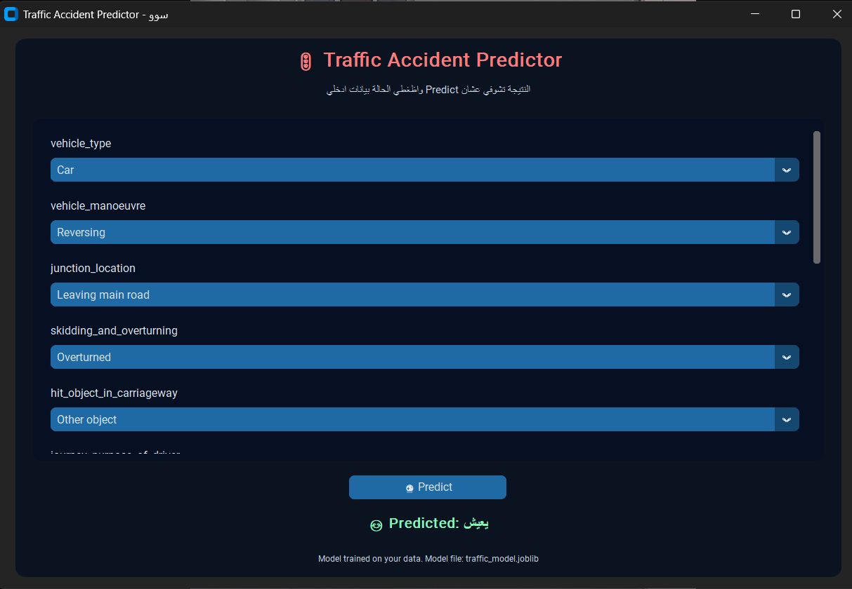

Current State:
AI Model GUI: Fully functional for accident severity prediction (Beta version)
Dashboard: Power BI dashboard integrated and ready for visualization
Key Testing Phases:
Unit Testing: Tested individual functions of the AI model for accuracy
Integration Testing: Ensured smooth interaction between GUI inputs, AI model, and Dashboard outputs
User Testing: Initial testing by project team to verify usability and correct predictions
Feedback / QA:
Predictions are mostly accurate with small adjustments needed for rare accident types
Dashboard visualizations are clear and easy to interpret
Positive feedback on AI interface simplicity and speed

Slide 8
Reports & Documentation:
Technical Specifications: AI model architecture, data preprocessing steps, algorithms used
User Manual: Guide for using AI GUI and Dashboard
Data Documentation: Description of dataset, features, and preprocessing
Timeline / Milestones:
Week 1–2: Data collection and cleaning
Week 3–4: AI model development and testing
Week 5: Dashboard creation and integration
Week 6: Final testing, documentation, and report preparation
Other Final Products:
Working AI Application GUI for accident severity prediction
Power BI Dashboard for data visualization
Source Code Repository (Python scripts, preprocessing notebooks, AI model files)

Slide 9
Core Team Members & Roles:
Sara Hamada Elzoghby & Mai Yousri Mostafa:
  Responsible for data cleaning, preprocessing, and AI model development
  All tasks implemented using Python
Hassan Khaled Goda & Elsayed Alaa Swelam:
  Responsible for database management and architecture
Salma Hesham Atalla & Mohamed Ashraf Dabash:
  Responsible for visualization and dashboard creation
Collaboration Methods:
Communication Tools: WhatsApp Version Control: GitHub for source code management
Project Management: Agile methodology with weekly sprints and milestone tracking

Slide 10


